Slide 1

Microwave-Specific Effects on Gas-Carbon Reactions
A.E. Stiegman
Department of Chemistry and Biochemistry
Florida State University
Tallahassee, FL

Slide 2
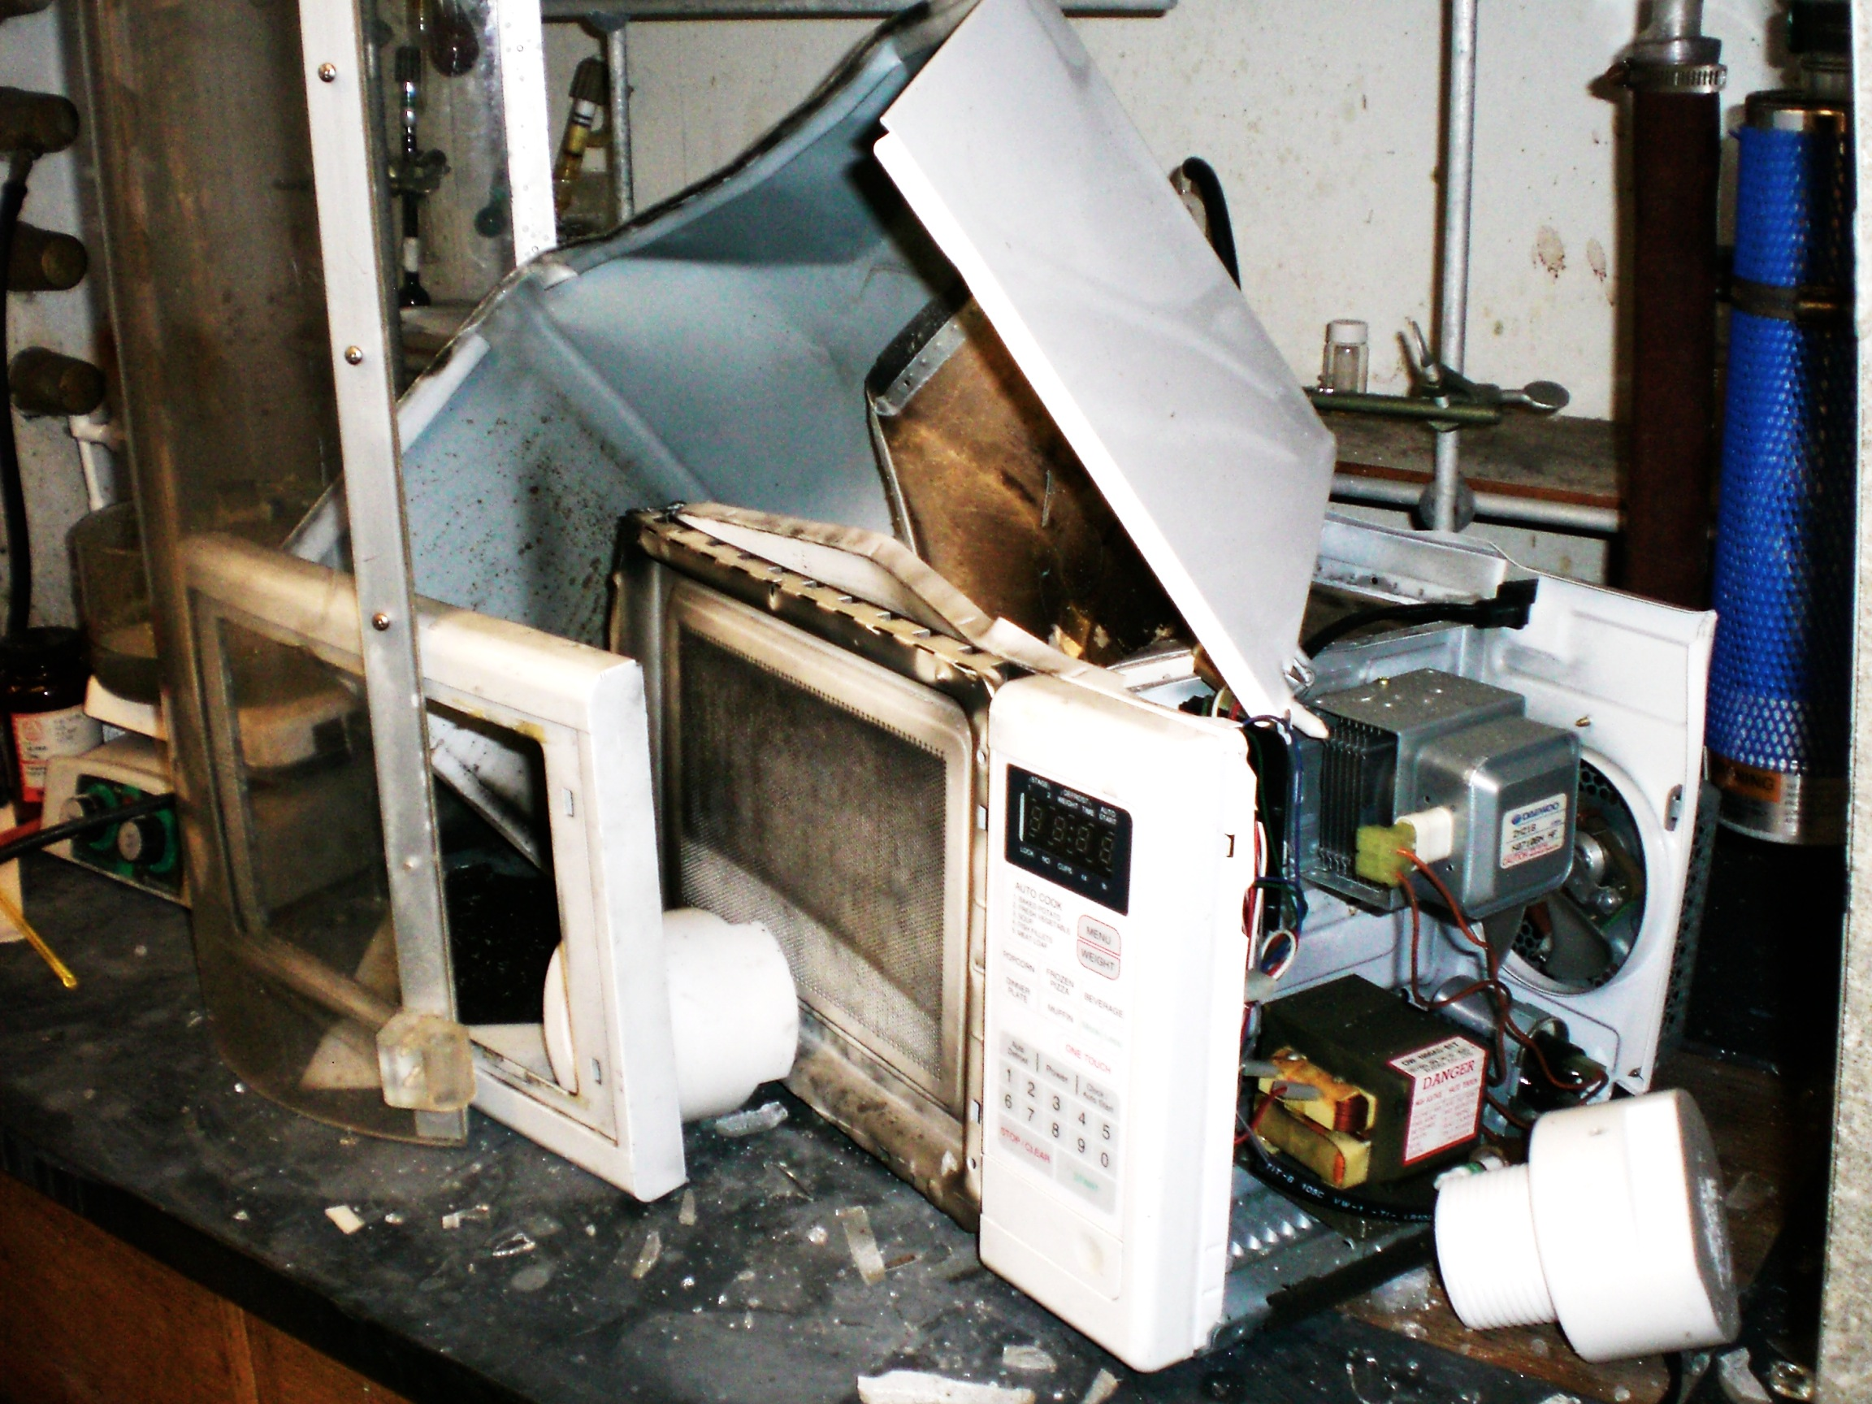
Our Early Efforts in Microwave Chemistry Were Inauspicious

Slide 3
Microwaves
The frequency range for the microwave region is typically designated as occurring from 0.3 GHz and 300 GHz (1 mm to 1 m).
Microwave heating of materials, solids and liquids, takes place a fixed frequency of 2.45 GHz corresponding to a wavelength of 12.25 cm.

Slide 4
Microwaves and Matter
Resonance vs Relaxation Processes
The absorption of microwave radiation by molecules and solid materials is a relaxation phenomenon.
At the energy of microwave radiation there are no known resonant absorption processes that can lead to chemical processes; bond making and bond breaking.

Slide 5
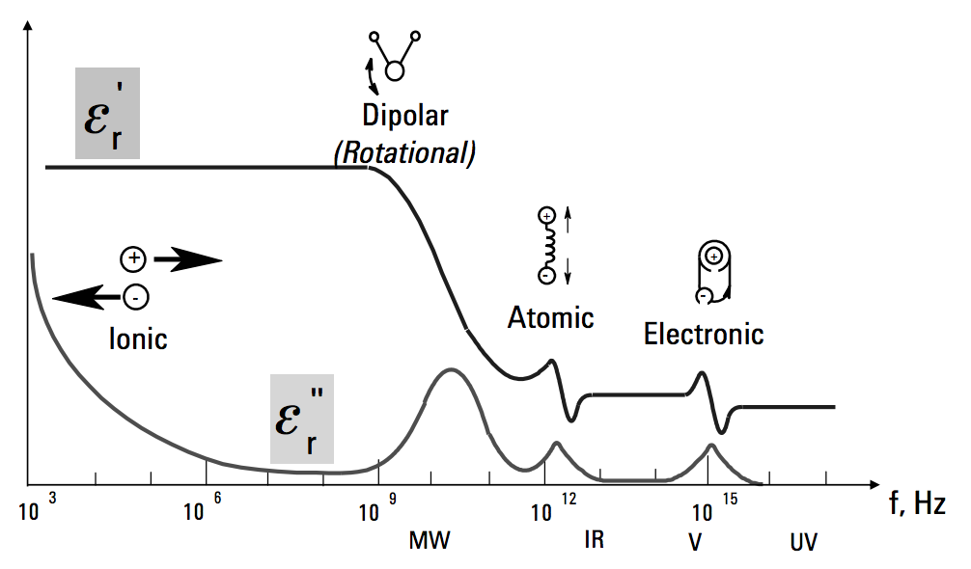
Absorption of Radiation

Slide 6
Microwave Heating in Homogeneous Solutions
Debye Theory of dipole interactions with electromagnetic radiation.
The oscillating electric field couples with the dipole moment.
This results in a torque on the molecule.
In a condensed medium, the oscillating molecule is collides with neighboring molecules which impede the relaxation.
The molecule oscillation is out of phase with the radiation. This is a loss process that generates heat.
The average power converted to heat

Slide 7
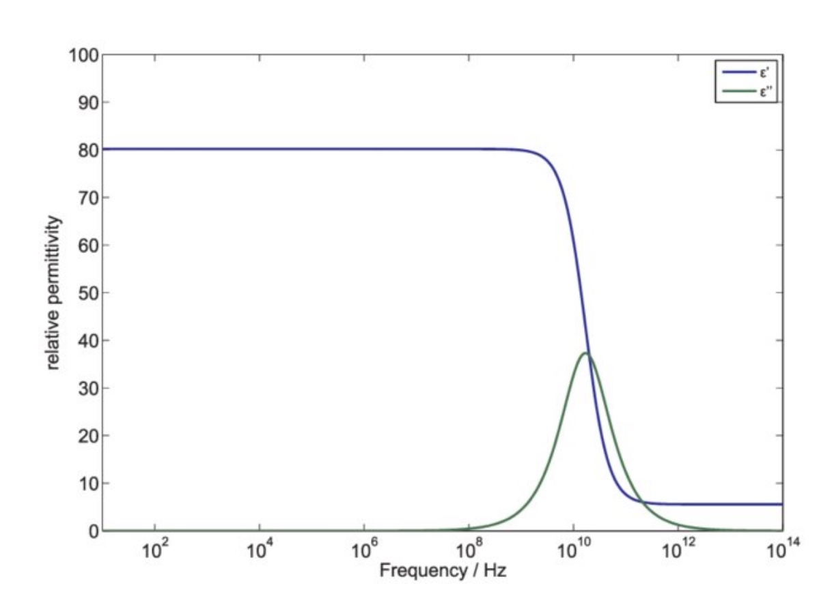
Microwave Heating in Homogeneous Solutions
Dielectric Spectrum of Water
A key parameter that describes these systems in the relaxation time (τ) which is a measure of how long the perturbed molecule takes to recover.
Relationship to molecular properties

Slide 8
Dielectric Loss Processes in Solids
Mechanisms for Dielectric loss in Solids
Conduction Loss
Space-Charge Recombination
Defect and Impurity Centers

Slide 9
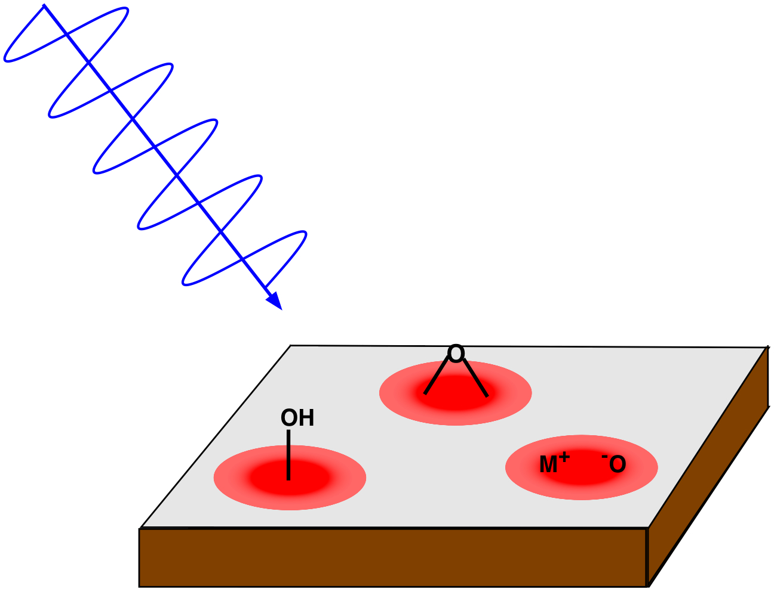
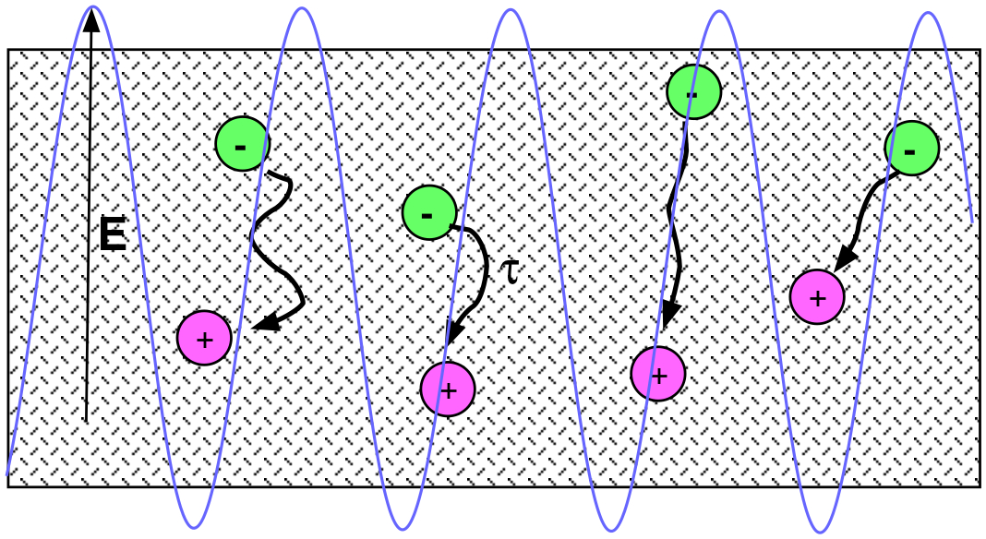
Debye Heating of surface dipoles.
Heating through space-charge recombination.

Slide 10
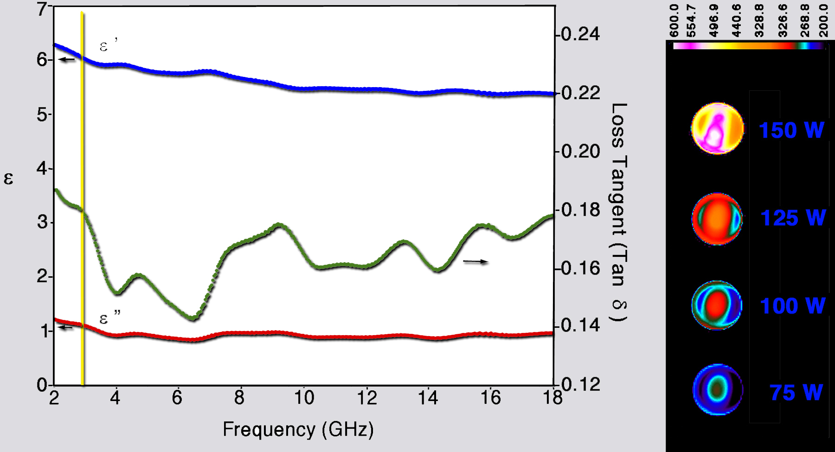
Dielectric Spectra and Microwave Heating of Carbon
Loss tangent=0.18(±0.02)

Slide 11
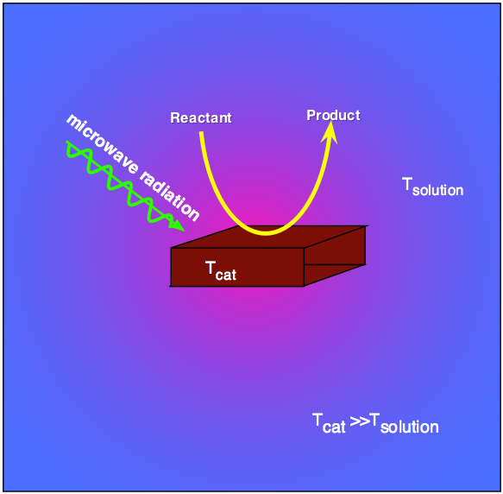
Microwaves and Heterogeneous Chemical Reactions
Our hypothesis was that selective heating of the catalyst and not the entire reaction can potentially represent a significant savings in energy.

Slide 12
Carbon Gasification Reactions
H₂O + C D CO + H₂ ΔH=+131 kJ/mol 1.
CO₂ + C D 2CO ΔH=+172 kJ/mol 2.
CO + H₂O D 2H₂ + CO₂ ΔH=-41 kJ/mol 3.
2H₂ + C D CH₄ ΔH=-75 kJ/mol 4.

Slide 13
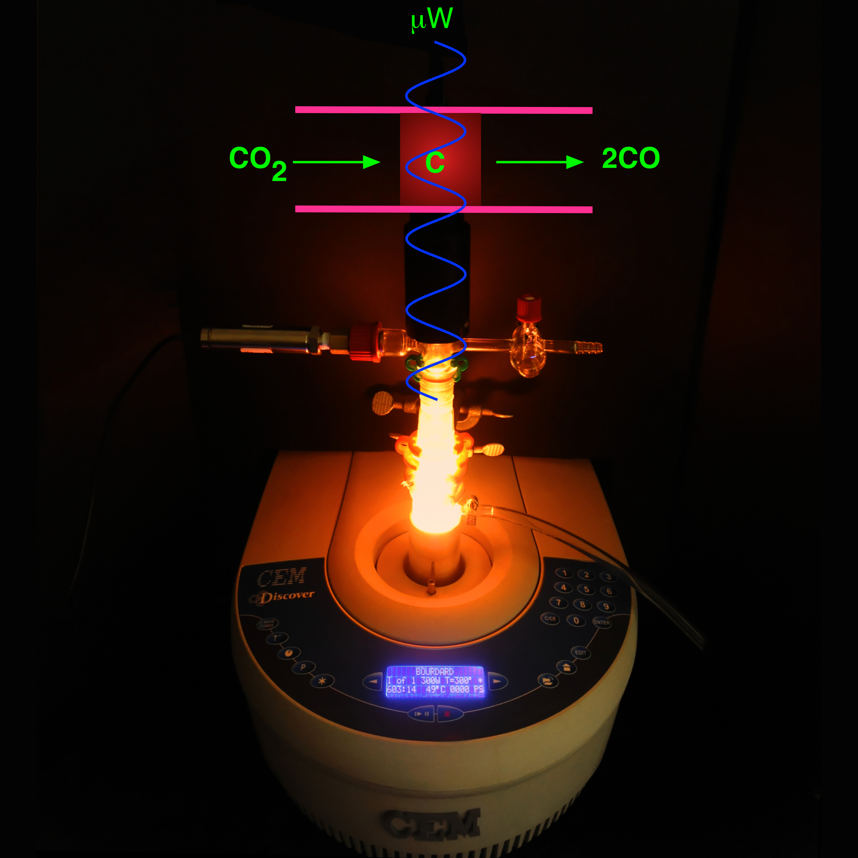
Studies of the Boudouard Reaction: CO₂ + C D 2CO

Slide 14
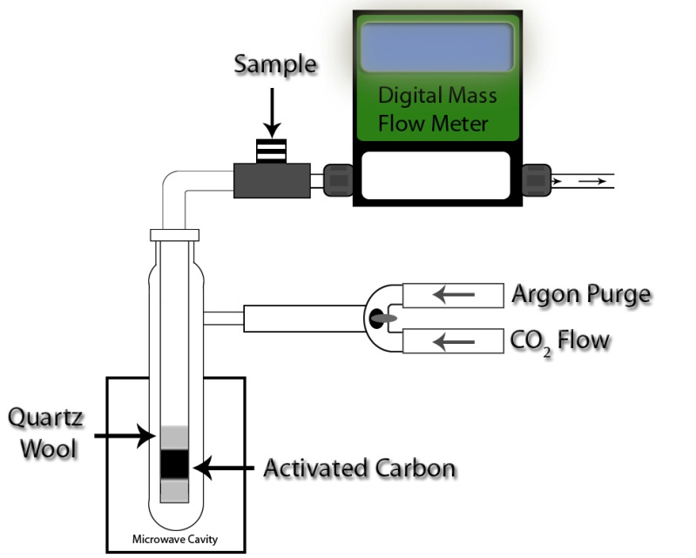
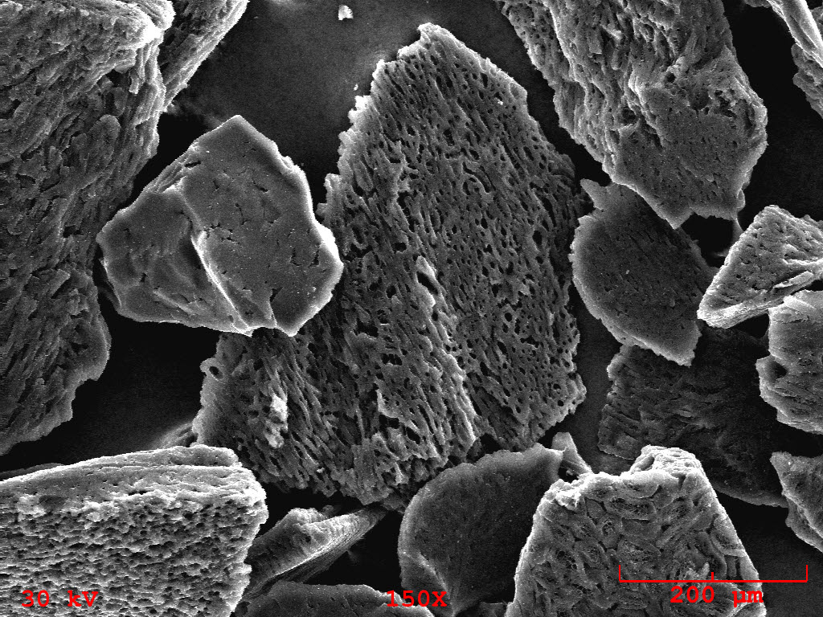
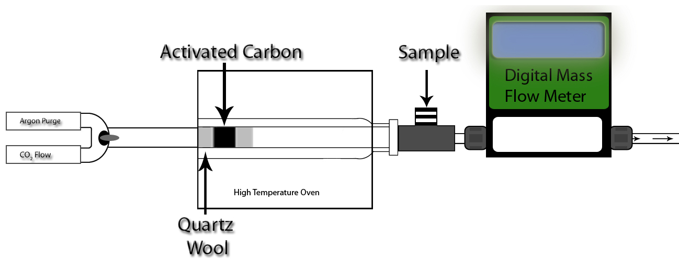
Experimental Protocol: Kinetic Experiments
High temperature activated charcoal
Surface area: 992 m²/g
Pore Volume: .236 cm³/g
Average Pore Size: 3.25 nm
Flow: 0.5 g, 11 mm diameter, flow rate for CO₂ 50 mL/min
Static: 1.0 g, 24 mm diameter

Slide 15
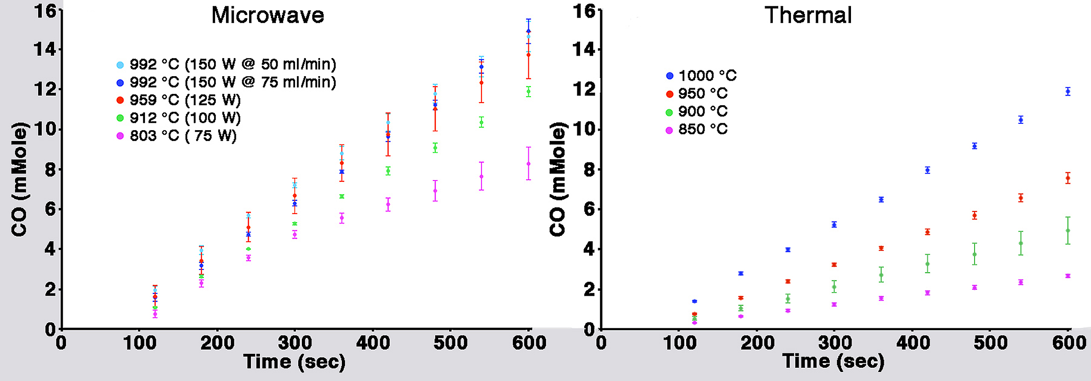
Kinetic Experiments

Slide 16
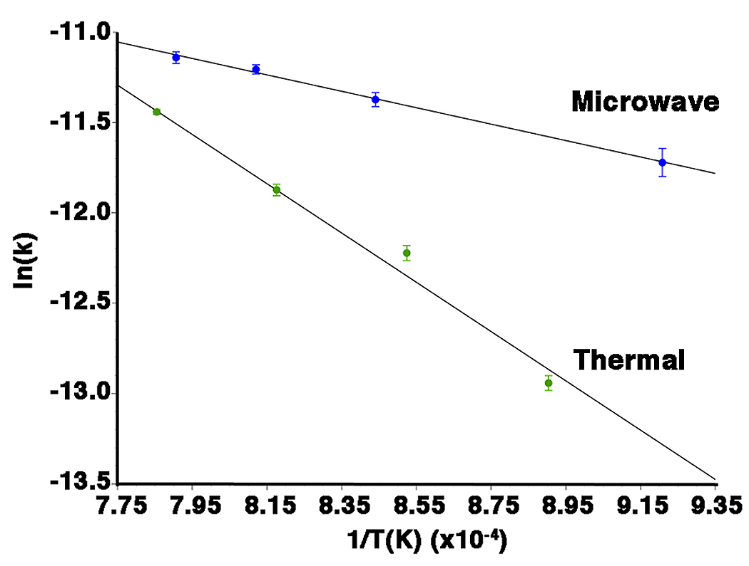
Arrhenius Parameters
Microwave:
E_{a}=37.79(±1.96) kJ/mole
A=5.66x10⁻⁴ /sec
Thermal: E_{a}=113.43(±7.44) kJ/mol
A=4.86x10⁻¹ /sec

Slide 17
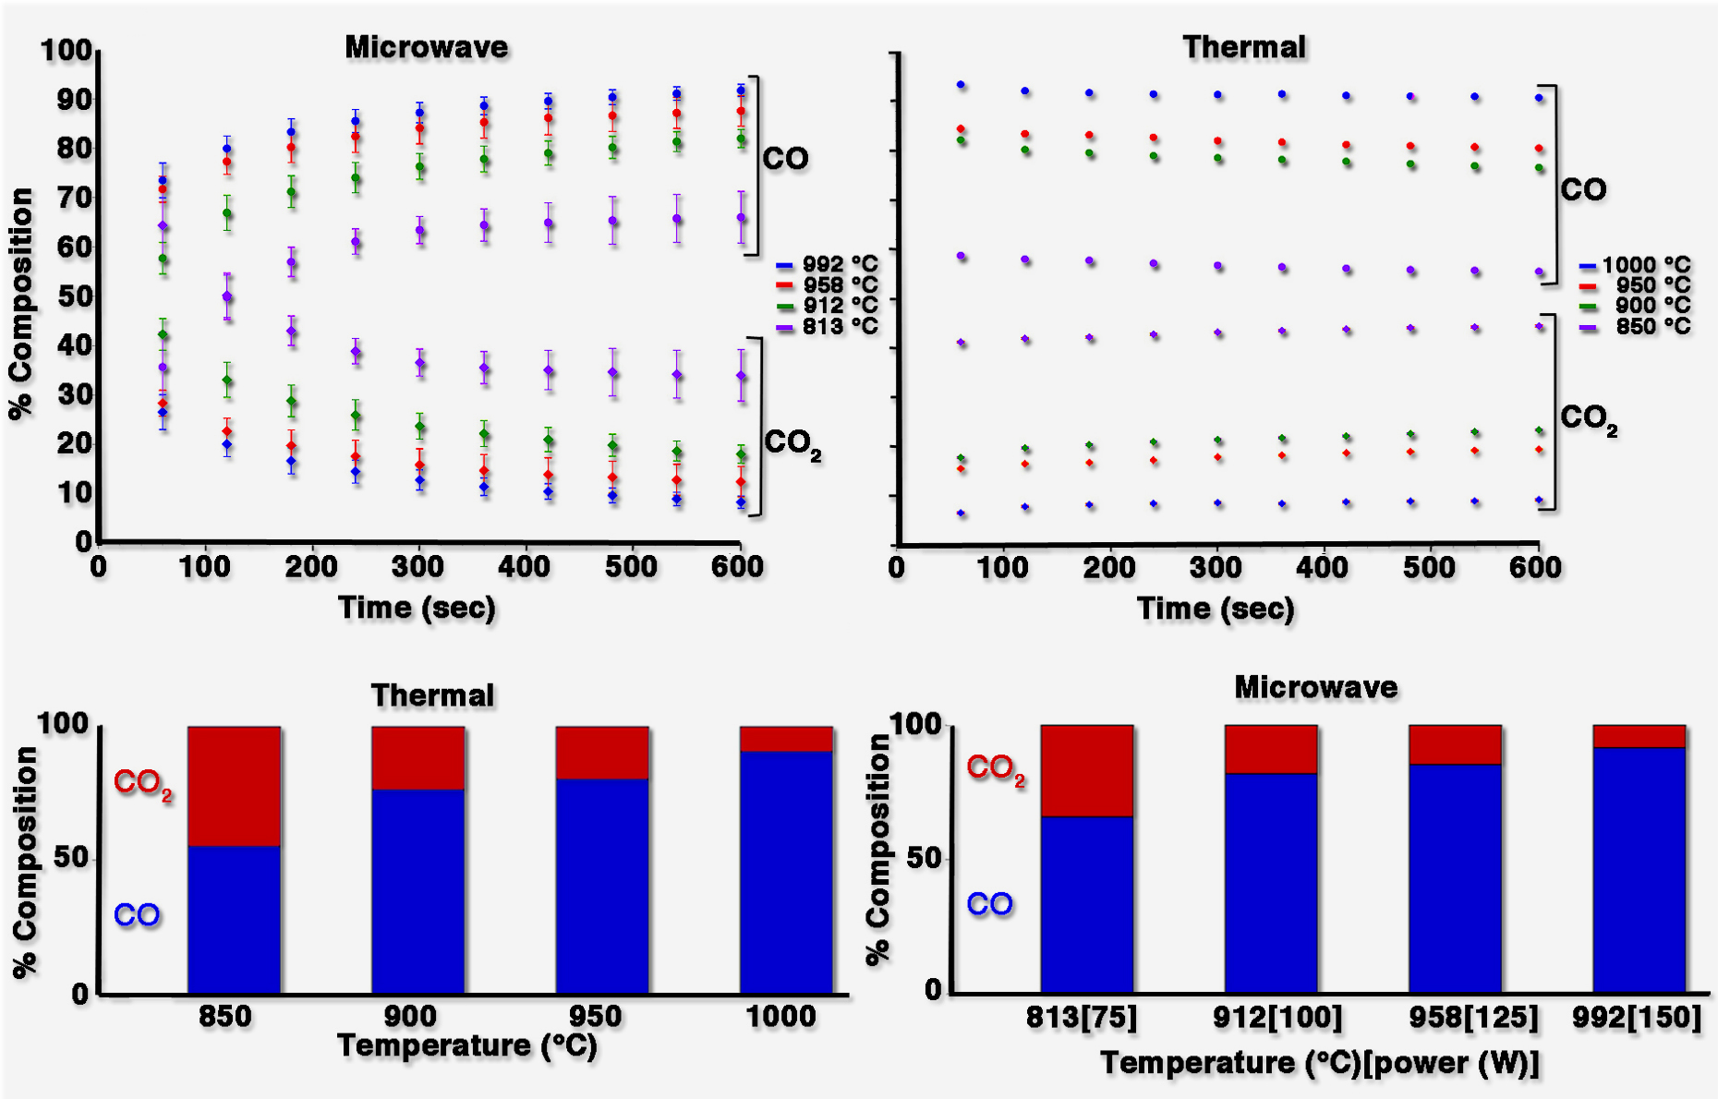
Product Composition
Gas Composition as a Function of Time and Temperature

Slide 18
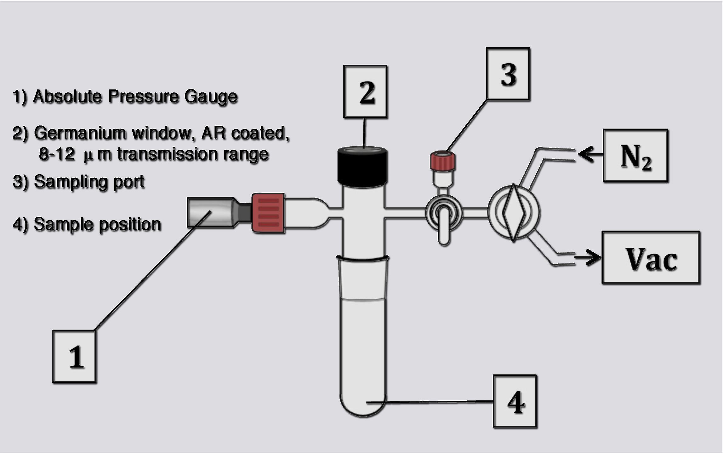
Equilibrium Determination

Slide 19
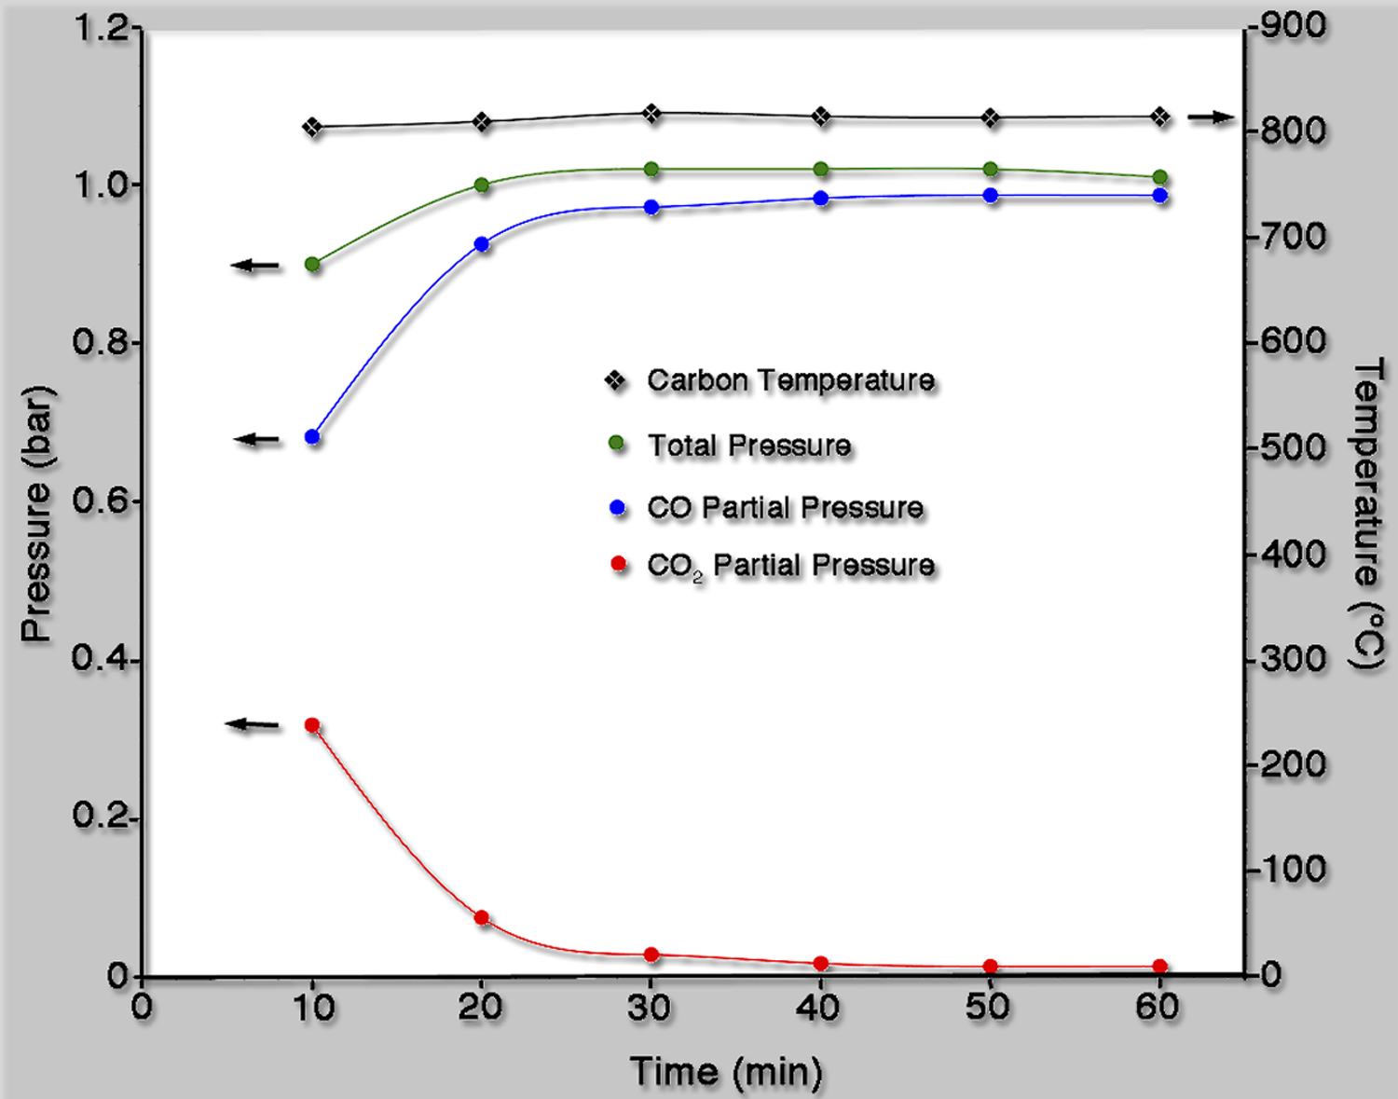
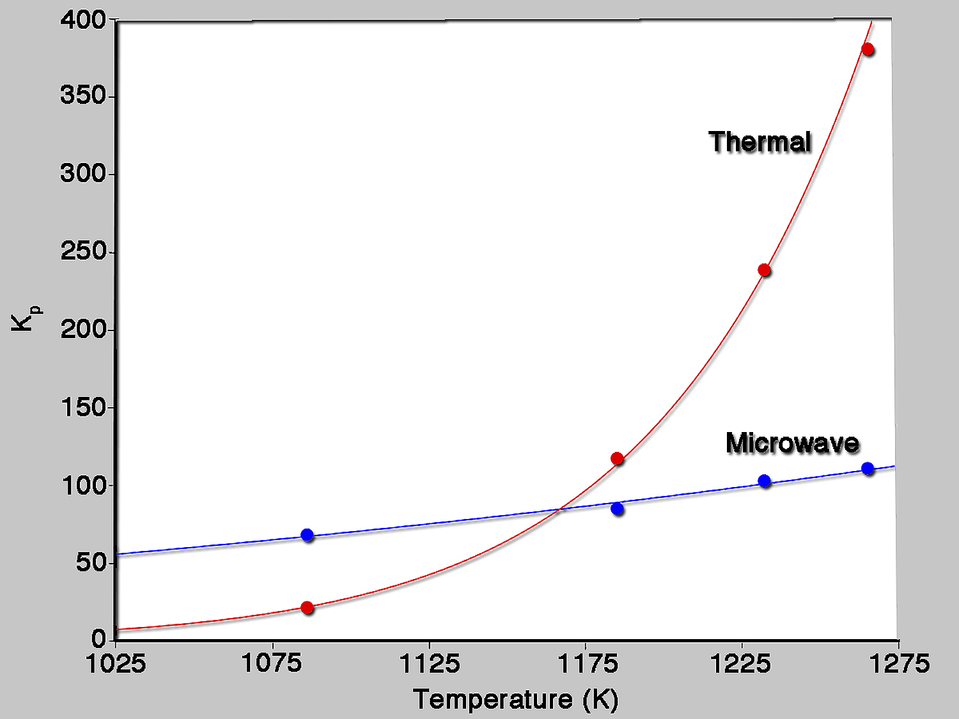
Static Experiments
Microwave
Thermal
T(K) | T(K) Gas | K_{p} | ΔG( kJ/mol) | T(K) | K_{p} | ΔG (kJ/mol)
1086 | 267 | 68.3(±10.6) | -38.1(±1.3) | 1086 | 21.6 | -27.7
1185 | 380 | 85.2(­±9.1) | -43.8(±1.0) | 1185 | 117.43 | -47.0
1232 | 390 | 103(±6.66) | -47.5(±0.64) | 1232 | 238.7 | -56.1
1265 | 404 | 111(±0.17) | -49.6(±0.02) | 1265 | 380.7 | -62.5

Slide 20
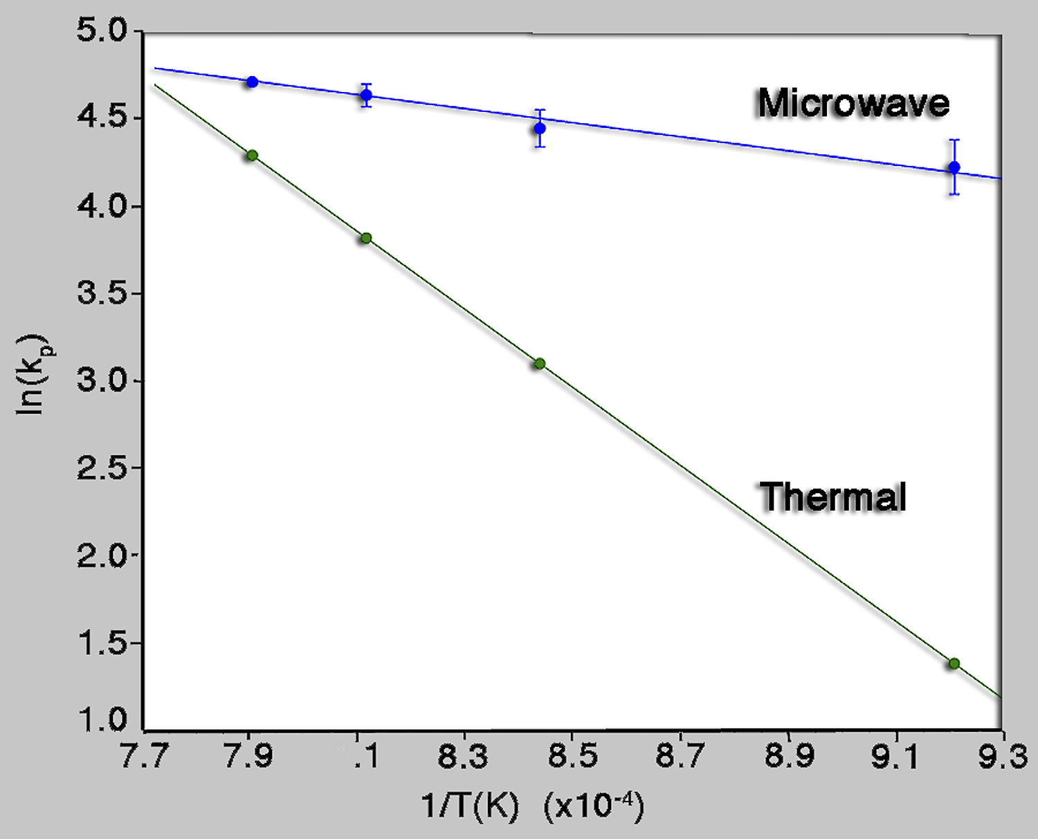
Enthalpy and Entropy
Van’t Hoff Plot
Microwave
ΔH = 33.4(±3.3) kJ/mole
ΔS =65.6 (±3.1) J/mol
Thermal
ΔH = 183.3 kJ/mole
ΔS = 194.3 J/mol

Slide 21
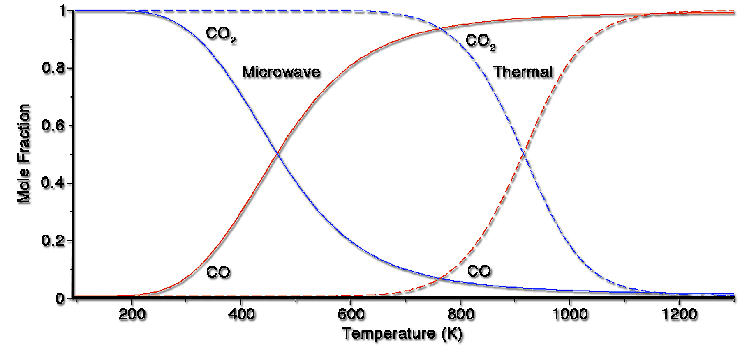
Microwave Effect on the Equilibrium

Slide 22
Gas-Carbon Equilibria
H₂O + C D CO + H₂ ΔH=+131 kJ/mol 1.
CO₂ + C D 2CO ΔH=+172 kJ/mol 2.
CO + H₂O D 2H₂ + CO₂ ΔH=-41 kJ/mol 3.
2H₂ + C D CH₄ ΔH=-75 kJ/mol 4.

Slide 23
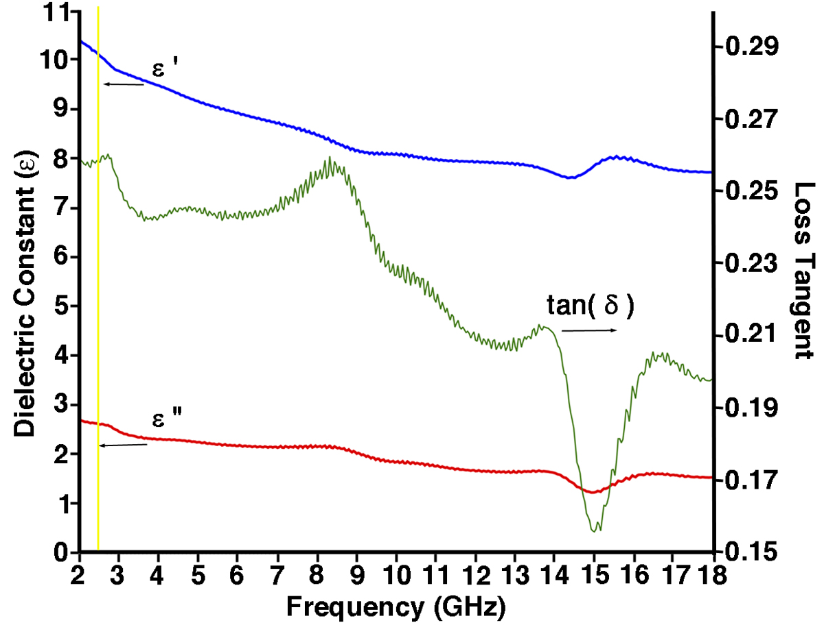
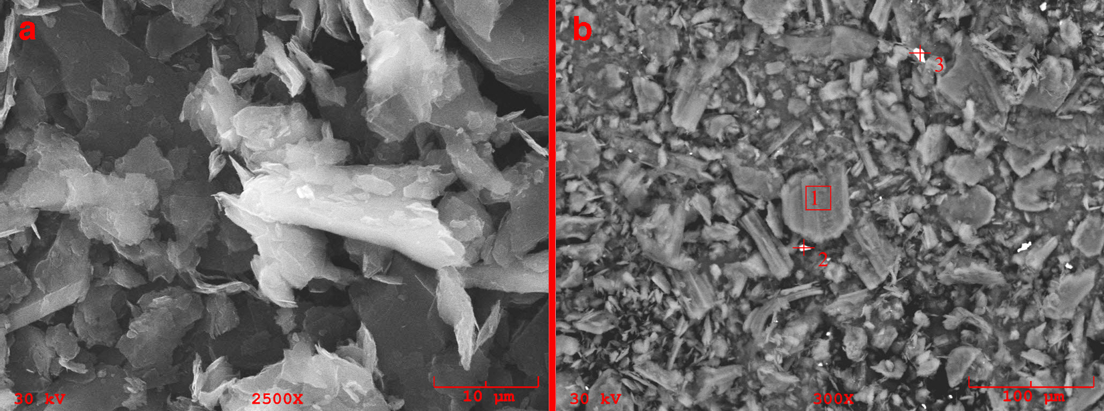
Carbon Properties
Graphite
Surface area: 7.6 m²/g
Loss tangent @ 2.45 GHz = 0.26(0.016)

Slide 24
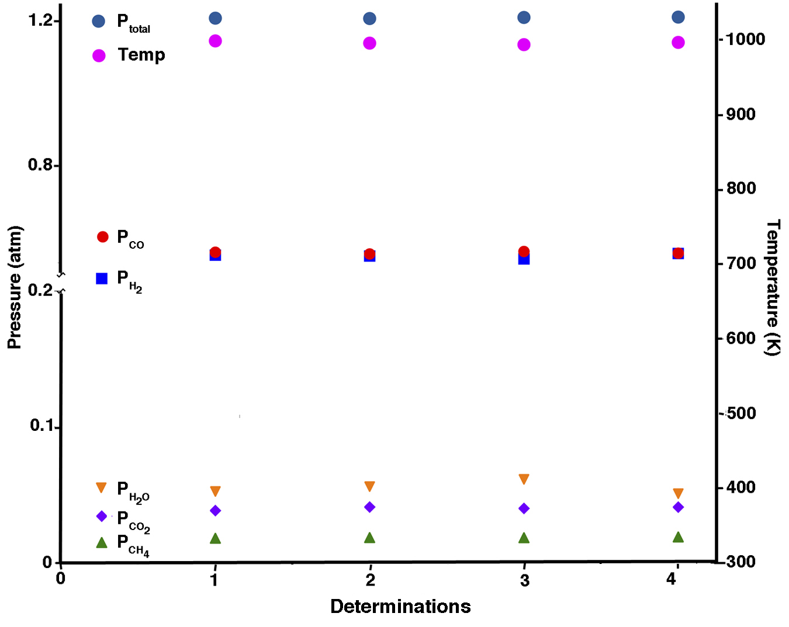
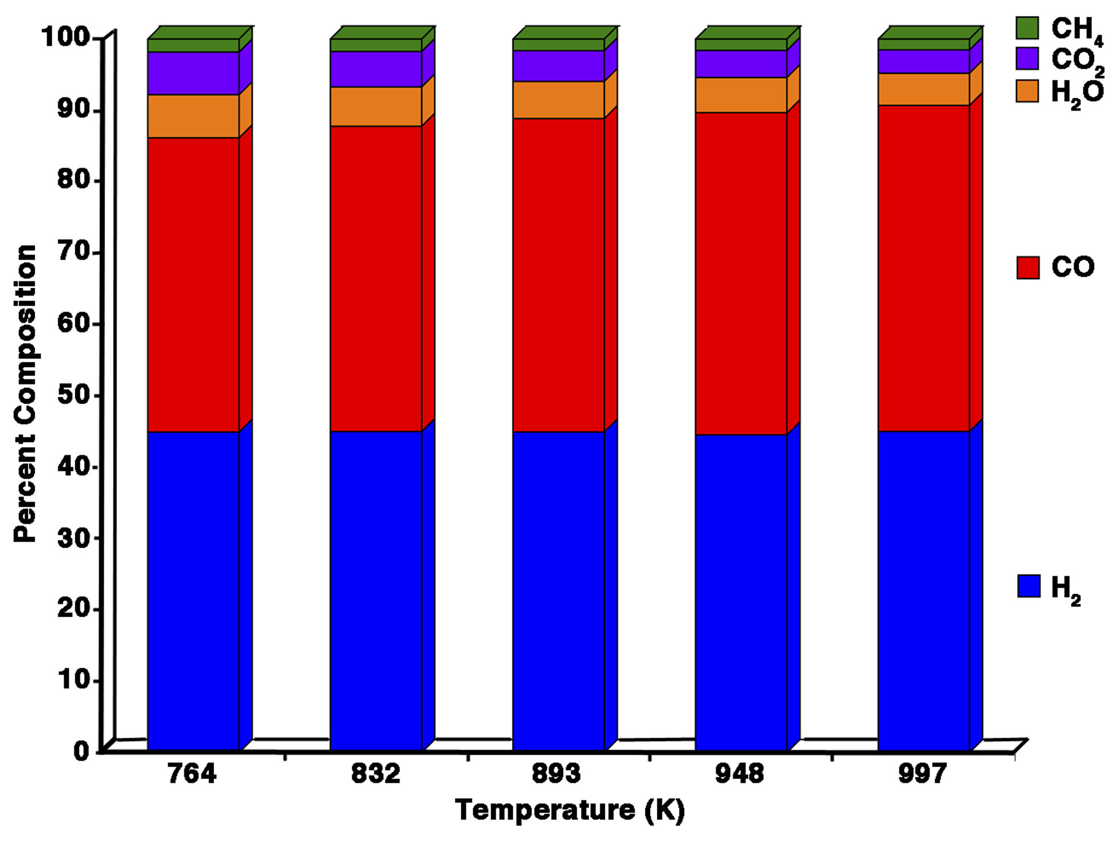
Equilibrium Composition

Slide 25
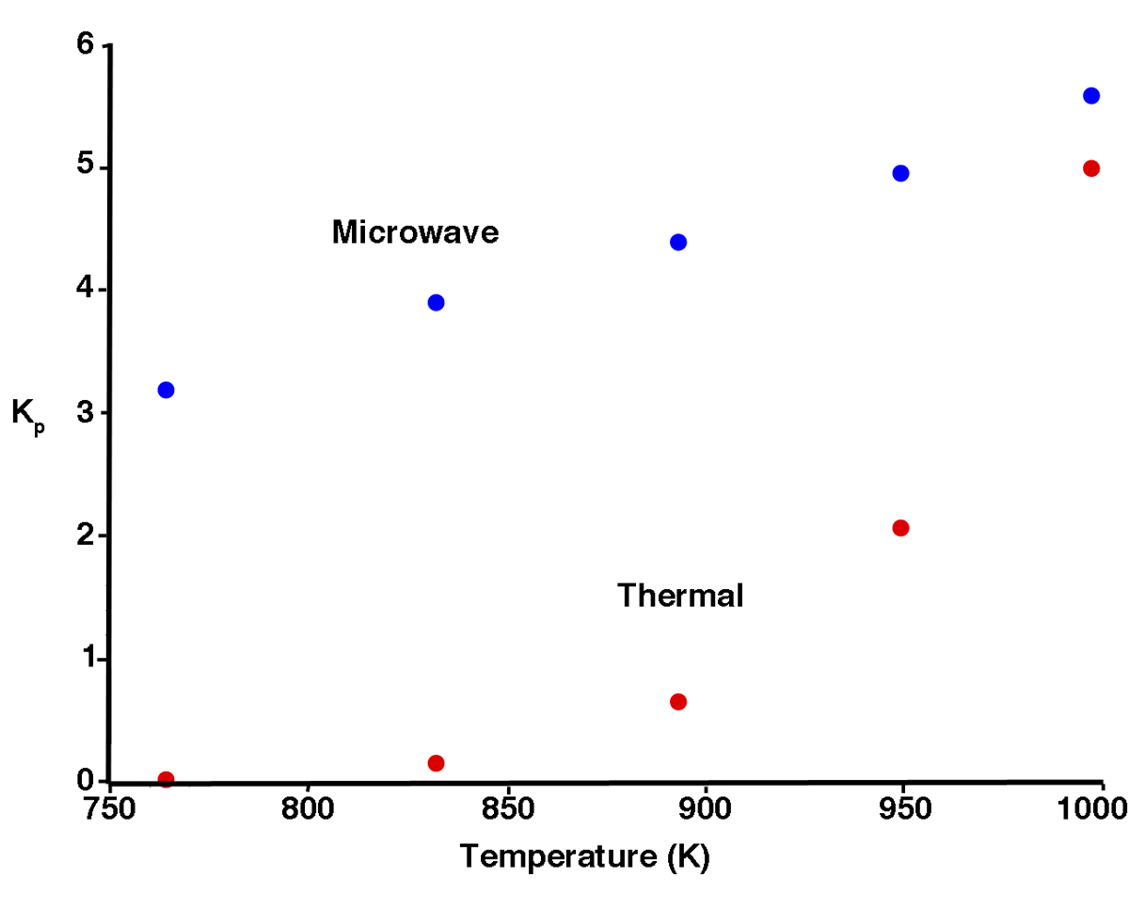
Equilibrium and Free Energy for the Steam-Carbon Reaction
Microwave
Thermal
T(K) | T(K) Gas | K_{p} | ΔG( kJ/mol) | T(K) | K_{p} | ΔG (kJ/mol)
764 | 293 | 3.19(±.53) | -7.4(±1.0) | 764 | 0.03 | 23.5
832 | 309 | 3.90(±.61) | -9.4(±1.0) | 832 | 0.16 | 12.8
893 | 321 | 4.39(±.43) | -11.0(±.7) | 893 | 0.66 | 3.12
949 | 331 | 4.95(±.50) | -12.6(±.8) | 949 | 2.07 | -5.74
997 | 337 | 5.61(±.48) | -14.3(±.7) | 997 | 4.99 | -13.33

Slide 26
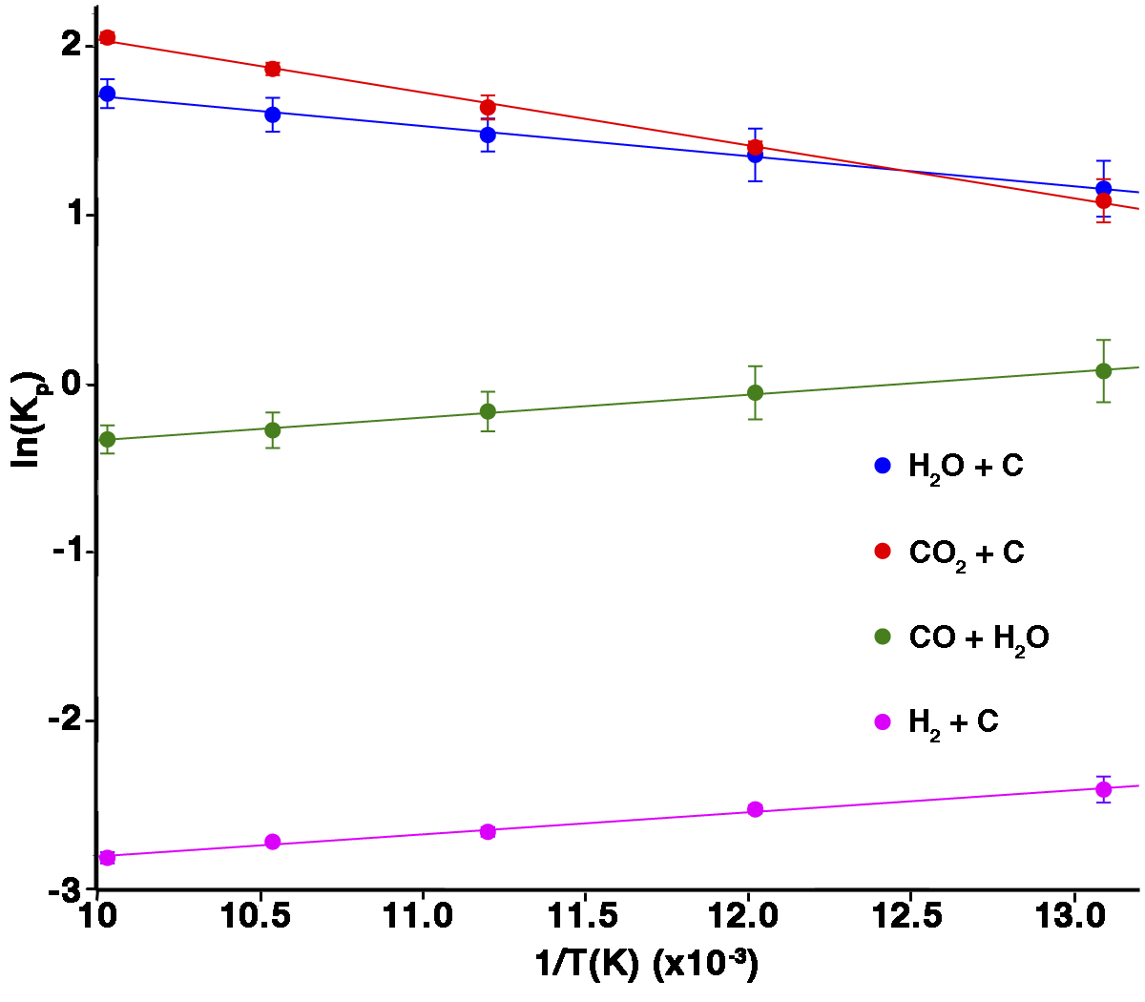
Thermodynamics of the Carbon-Steam Reaction in the Microwave
 | Microwave |  | Thermal
 | ΔH (kJ/mol) | ΔS (J/K mol) | ΔH (kJ/mol) | ΔS (J/K mol)
Steam-C | 15.2 | 29.5 | 144.2 | 158.1
Boudouard | 27.0 | 43.1 | 180.2 | 191.2
Water-gas | -11.4 | -14.1 | -36.0 | -58.1
Carbon-H | -9.1 | -32.2 | -79.7 | -90.4

Slide 27
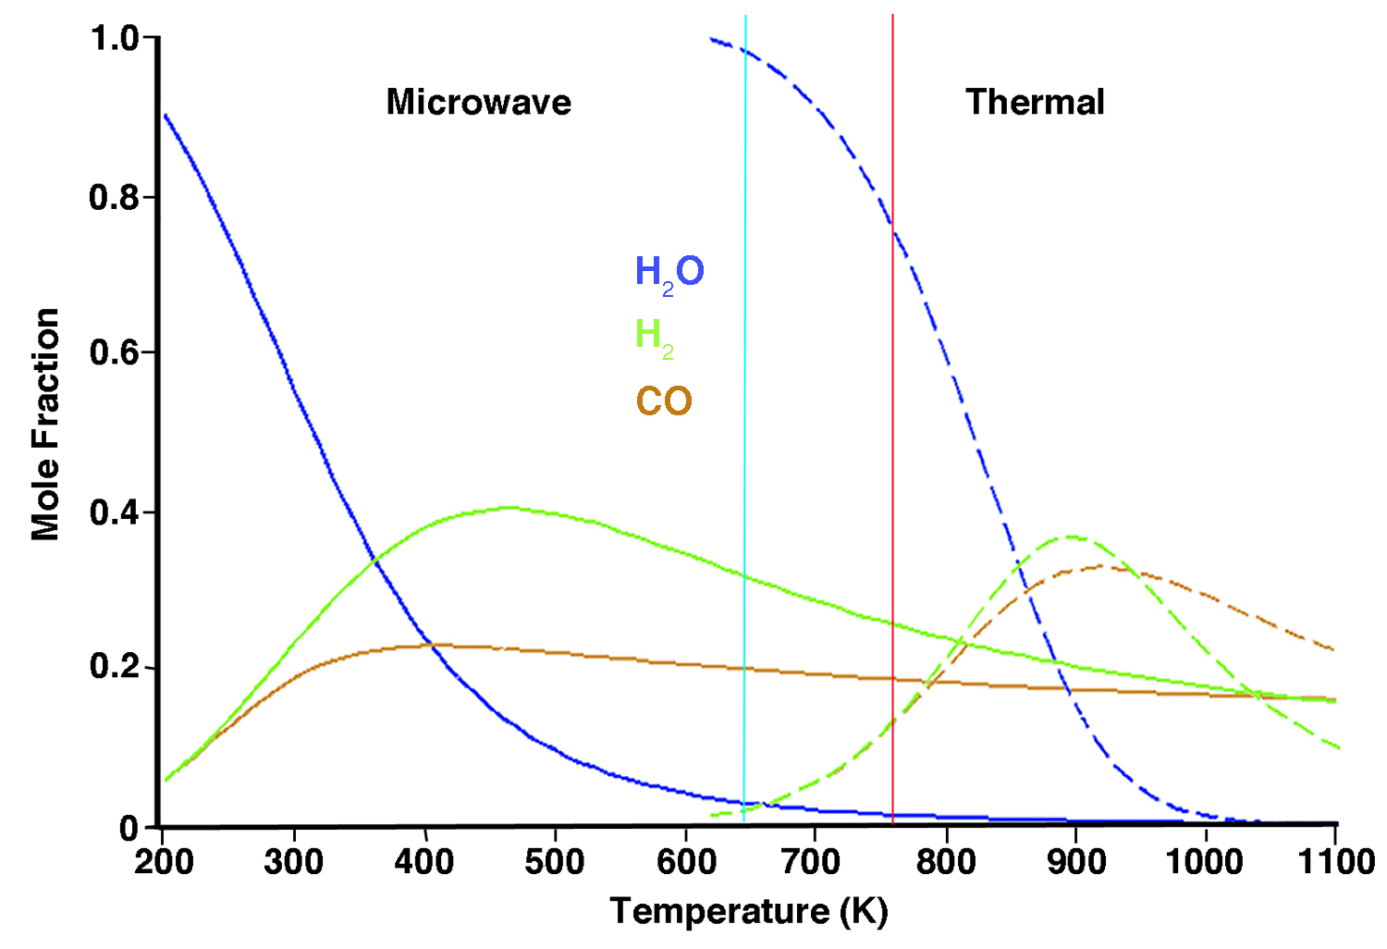
Microwave Effect on the Equilibrium

Slide 28
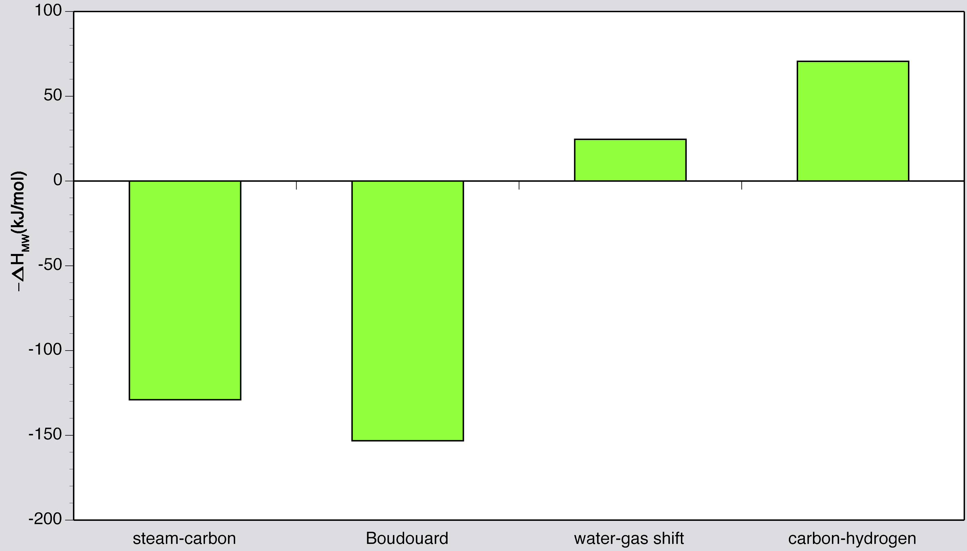
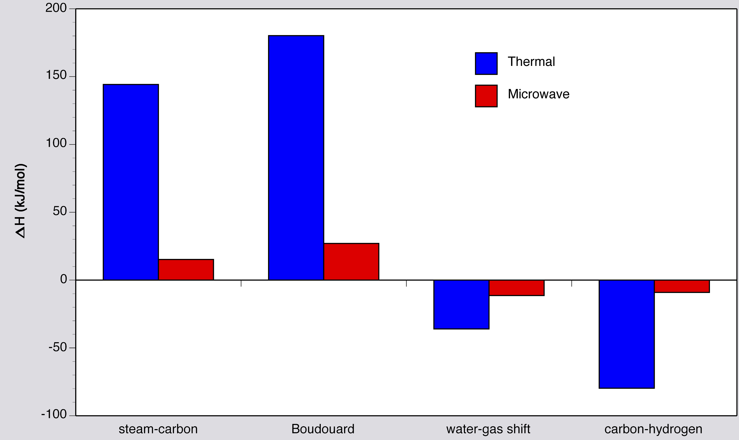
Thermodynamic Considerations of the Microwave Effect

Slide 29
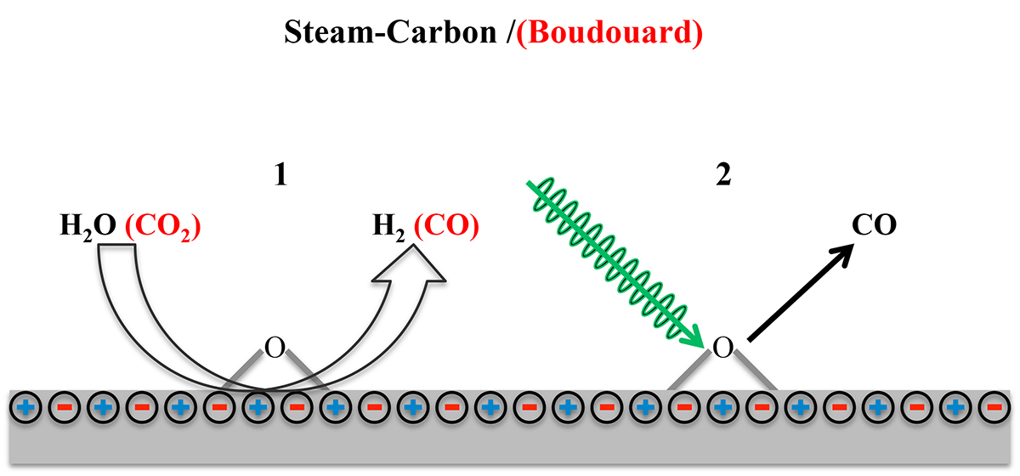
Origin of Microwave Effect and a Proposed Mechanism
The microwave accelerates the forward reaction relative to the reverse reaction

Slide 30
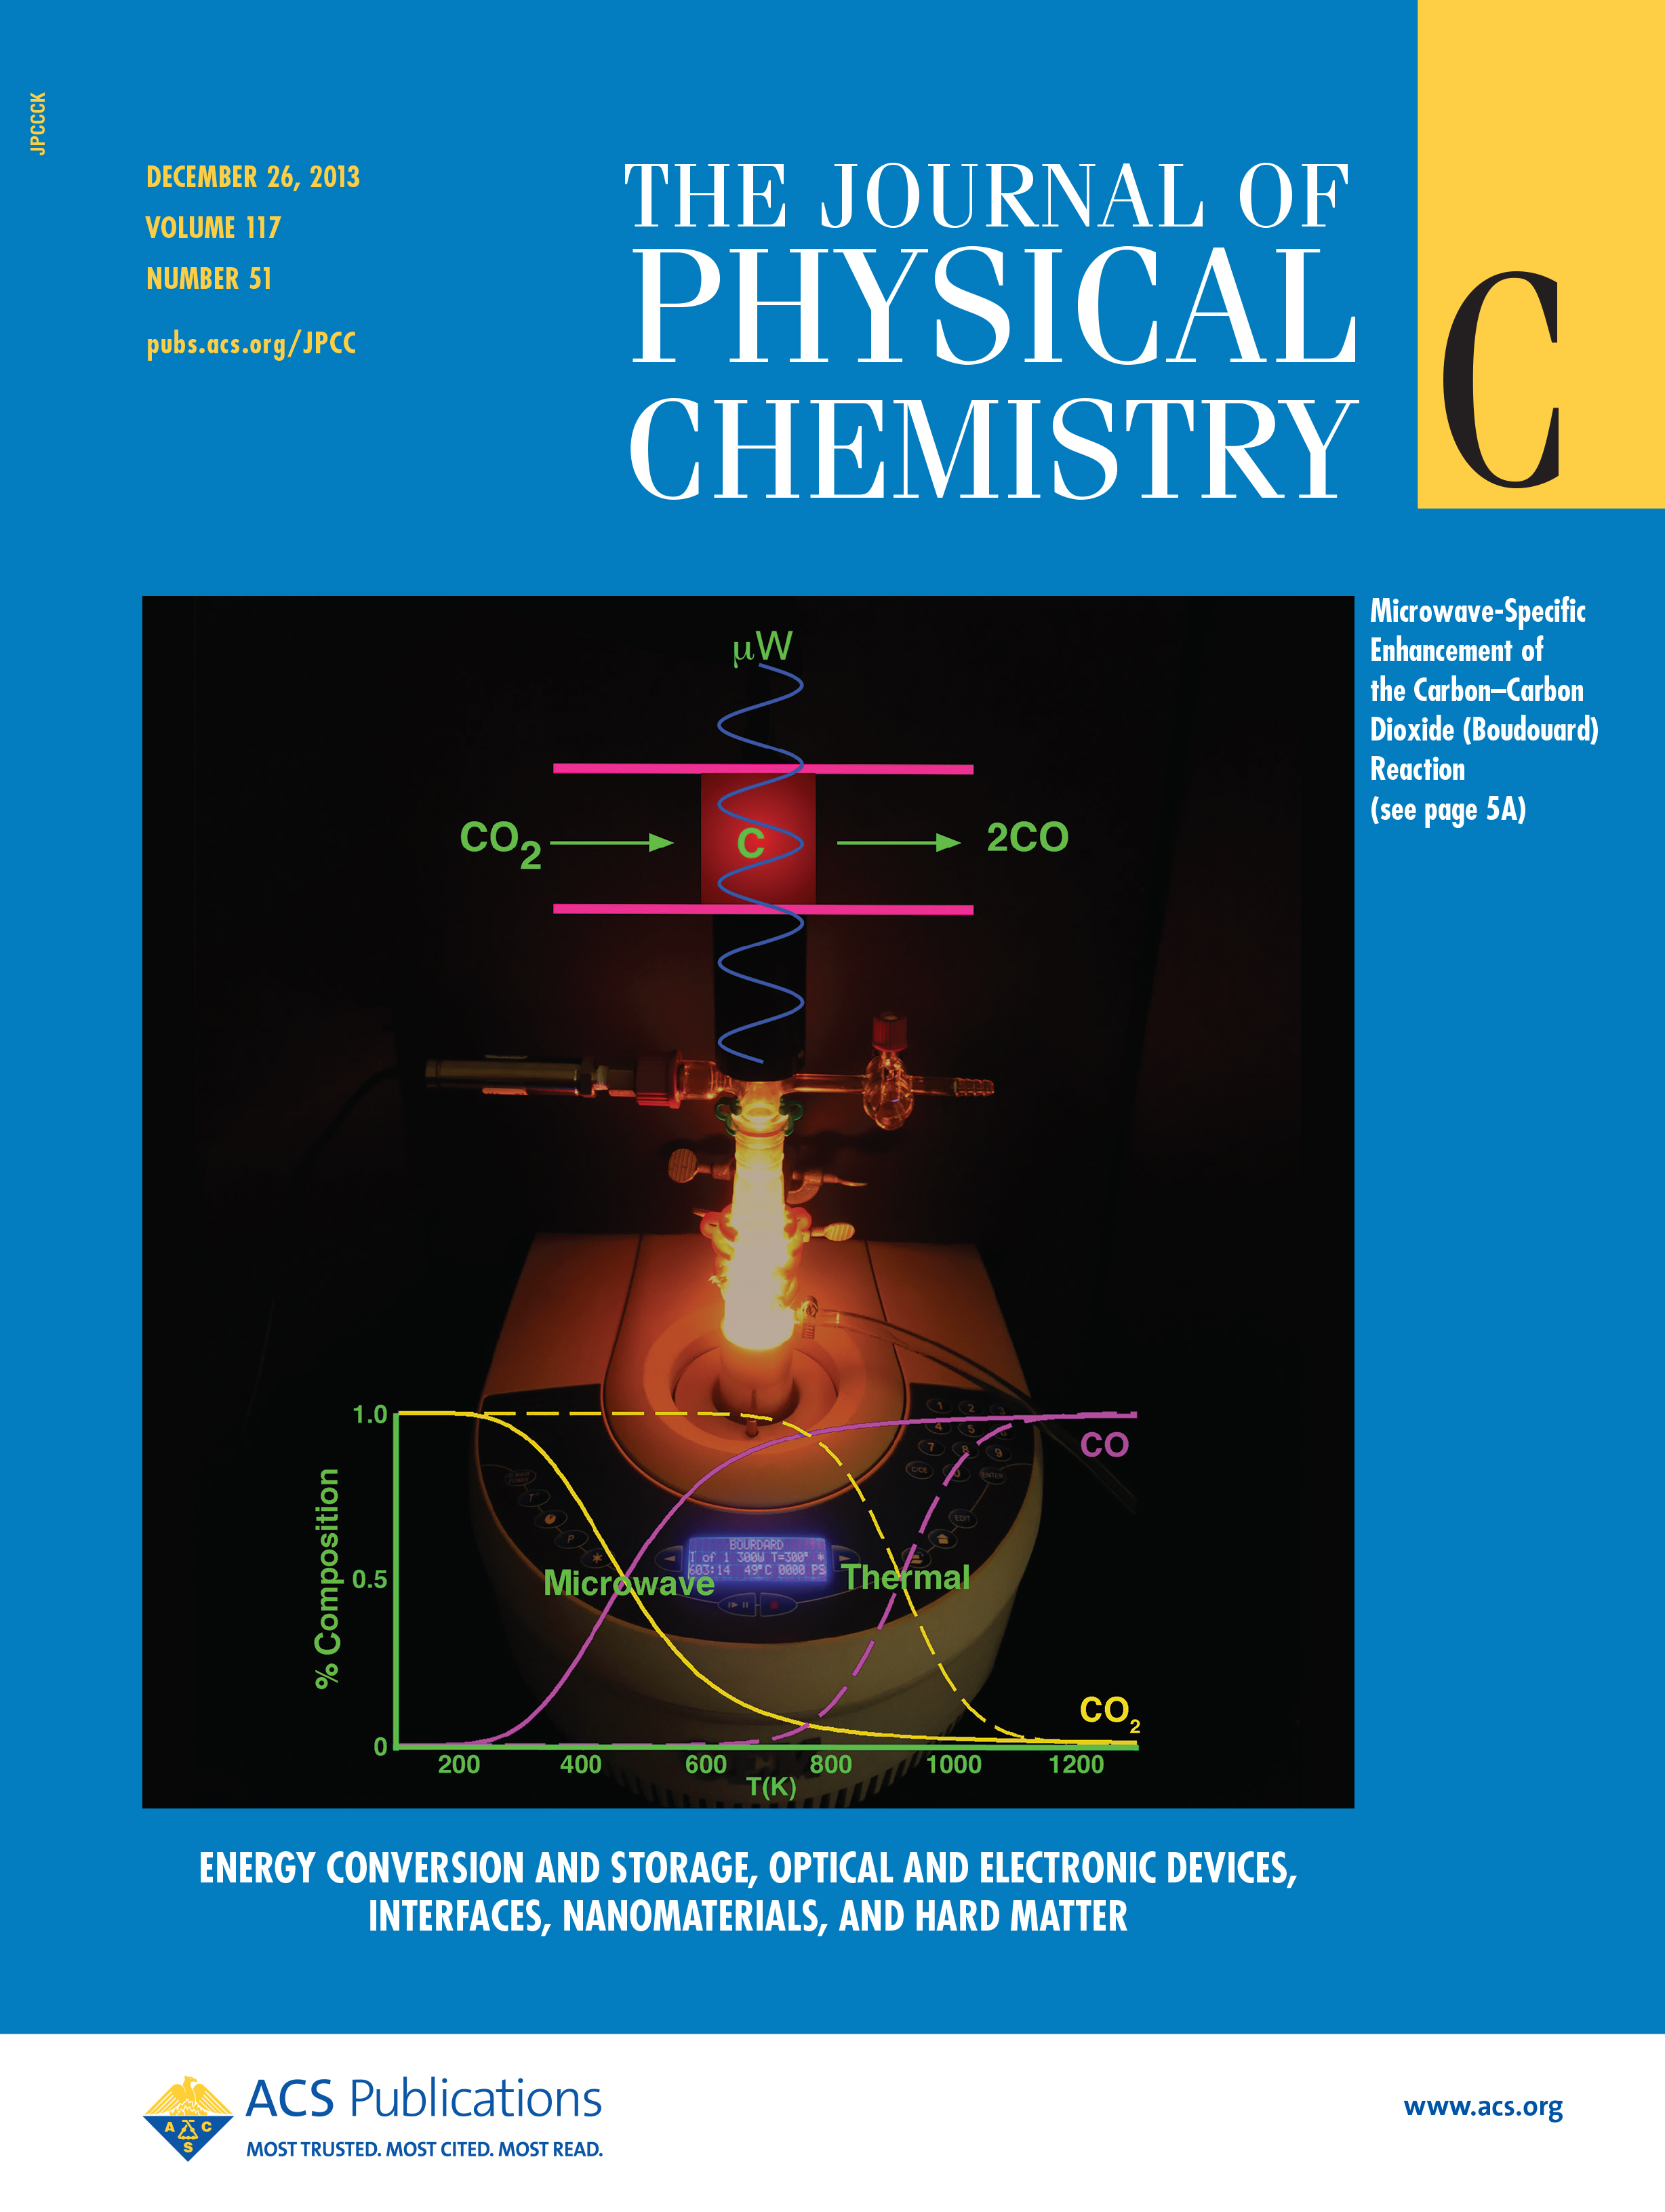
Conclusion
Microwaves radiation can do far more than just heat a reaction or a catalyst.
It can change change both the apparent thermodynamics of the reactions and can affect the products of the reaction.

Slide 31
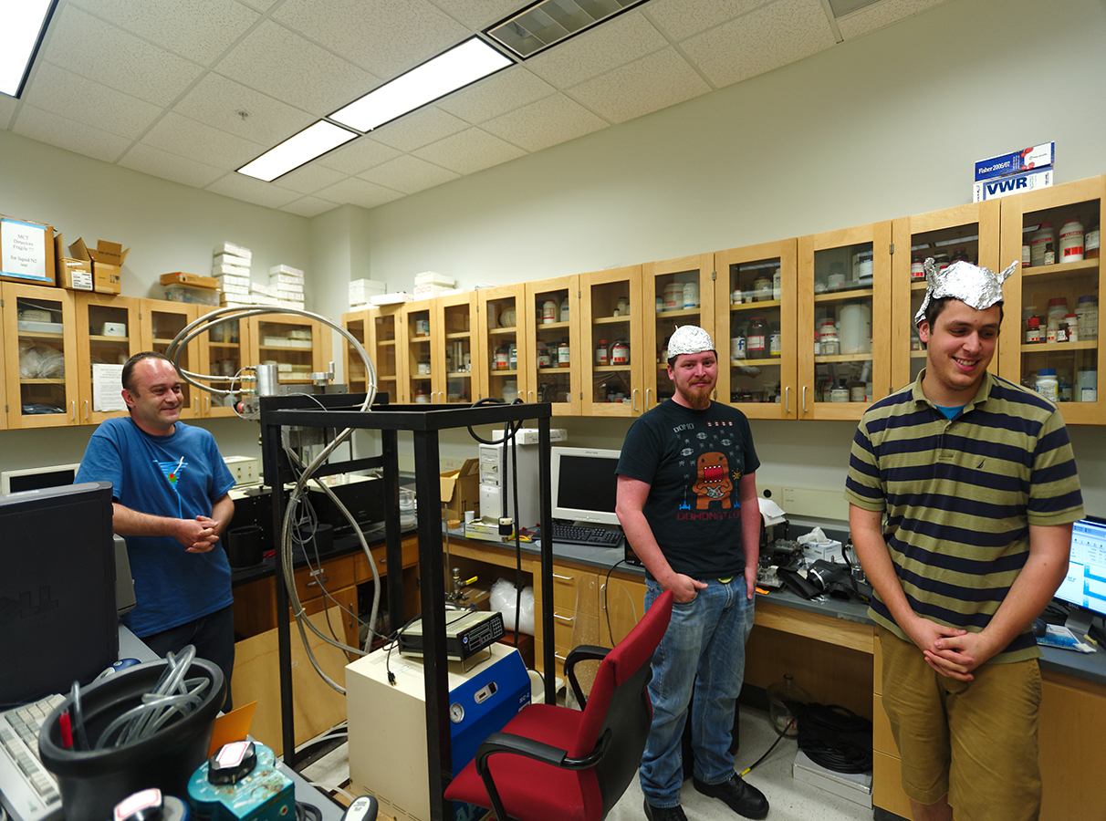
Acknowledgements
Jake Hunt
Tony Ferrari
Mark Crosswhite
Adrian Lita
Bridgett Ashley
Tom Dusek
$$$ NSF and DOE

Slide 32
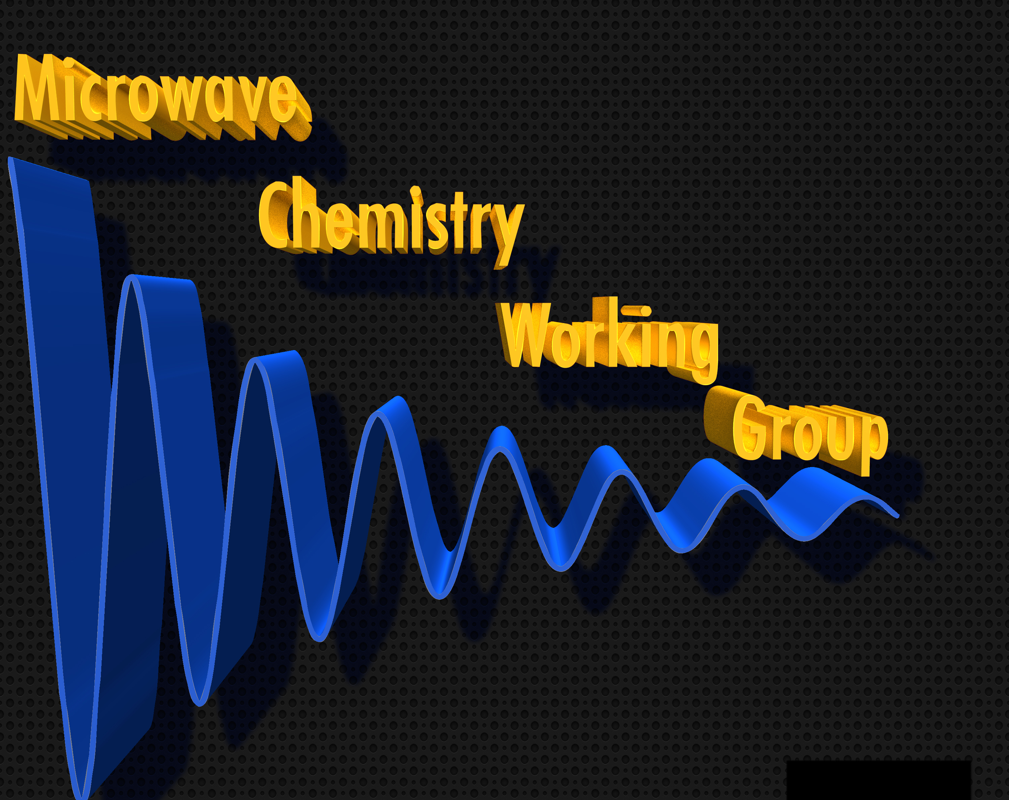
Microwave Chemistry Working Group
FSU Chemistry
Al Stiegman
Greg Dudley
Geoff Strouse
Susan Latturner
FSU Chemical Engineering
John Telotte
Tyndall AFB
Jeff Owens
Bridgett Ashley
Derek Lovingood
chem.fsu.edu/mcwg

